Slide 1
Time-series analysis

Slide 2
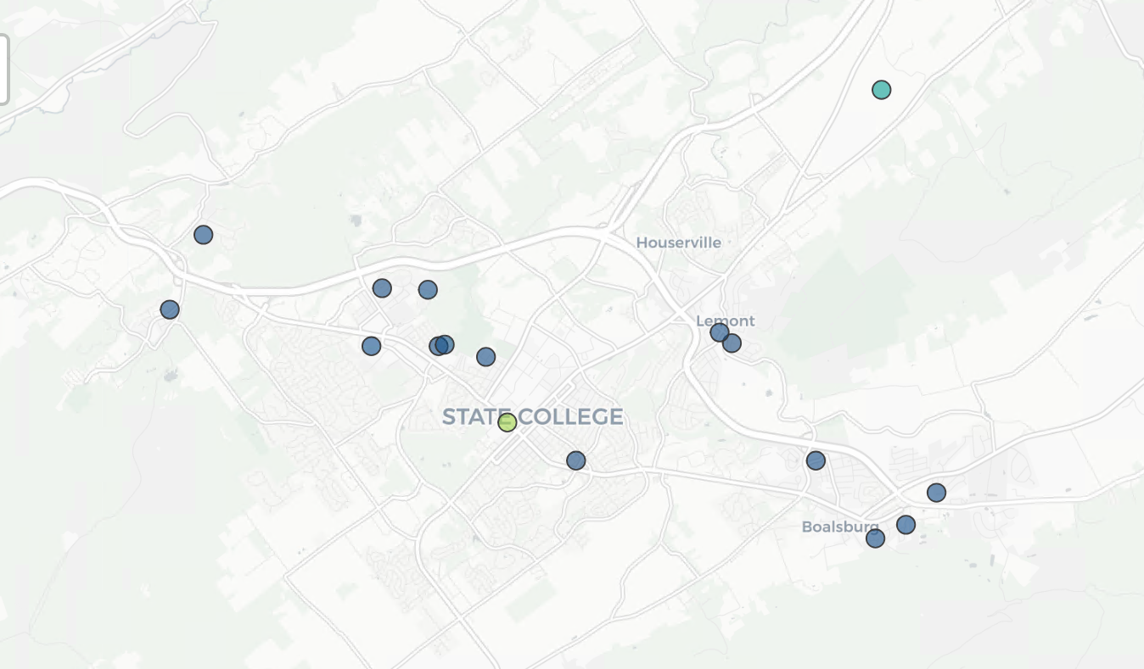
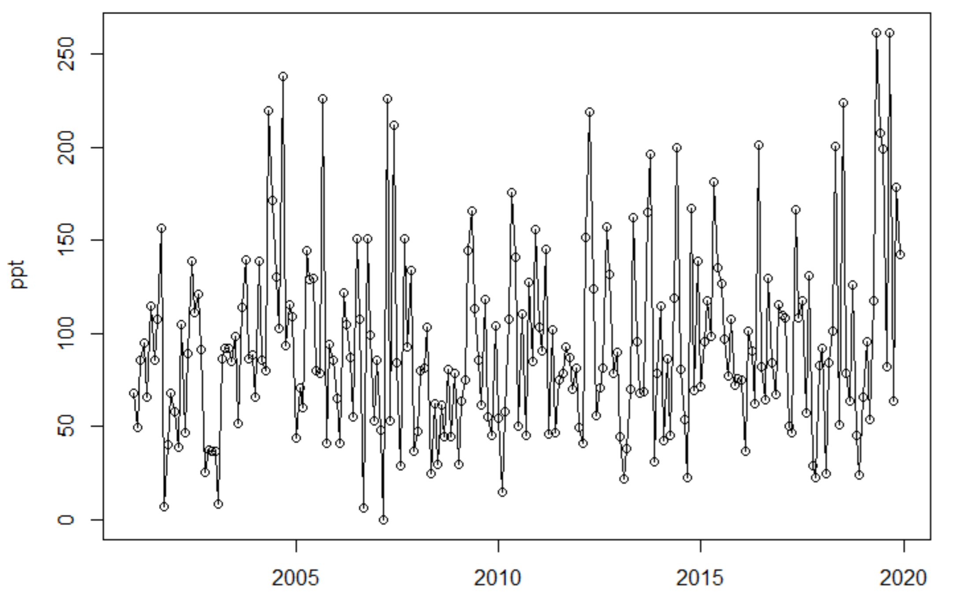
Example: time-series of daily ppt

Slide 3
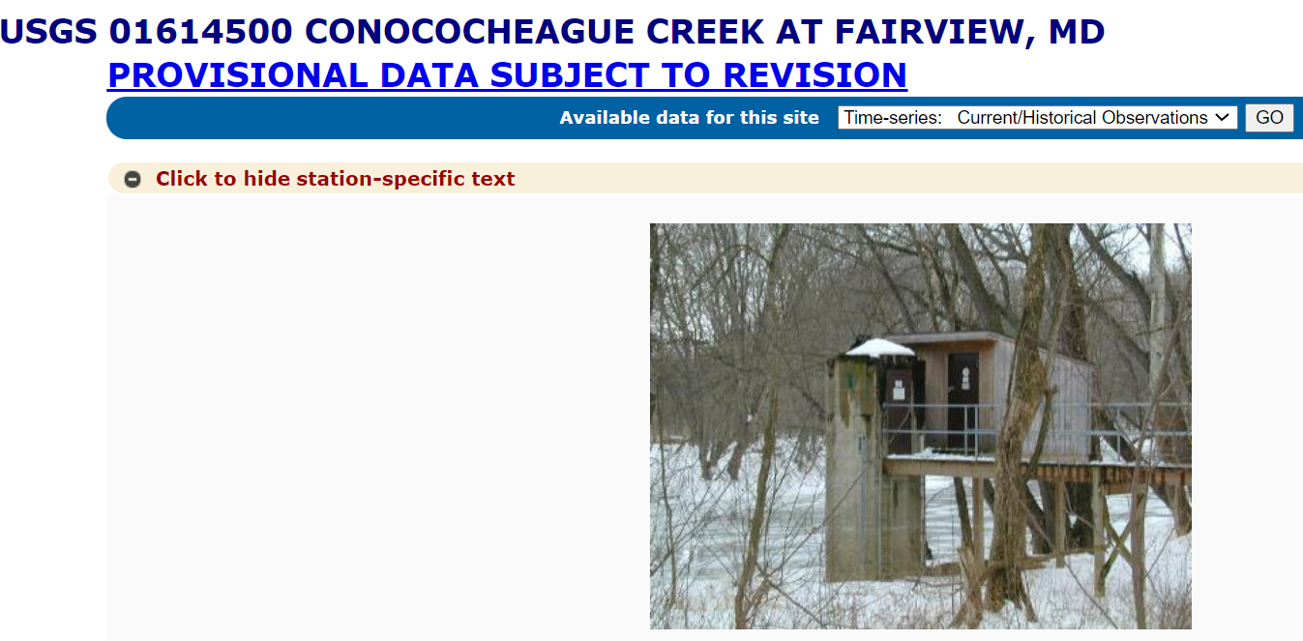
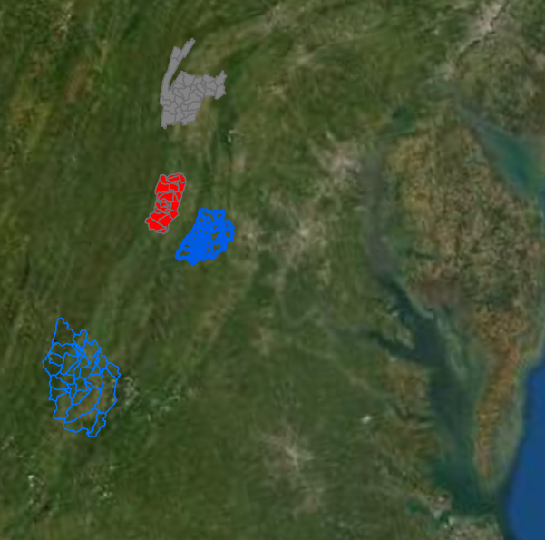
USGS streamflow

Slide 4
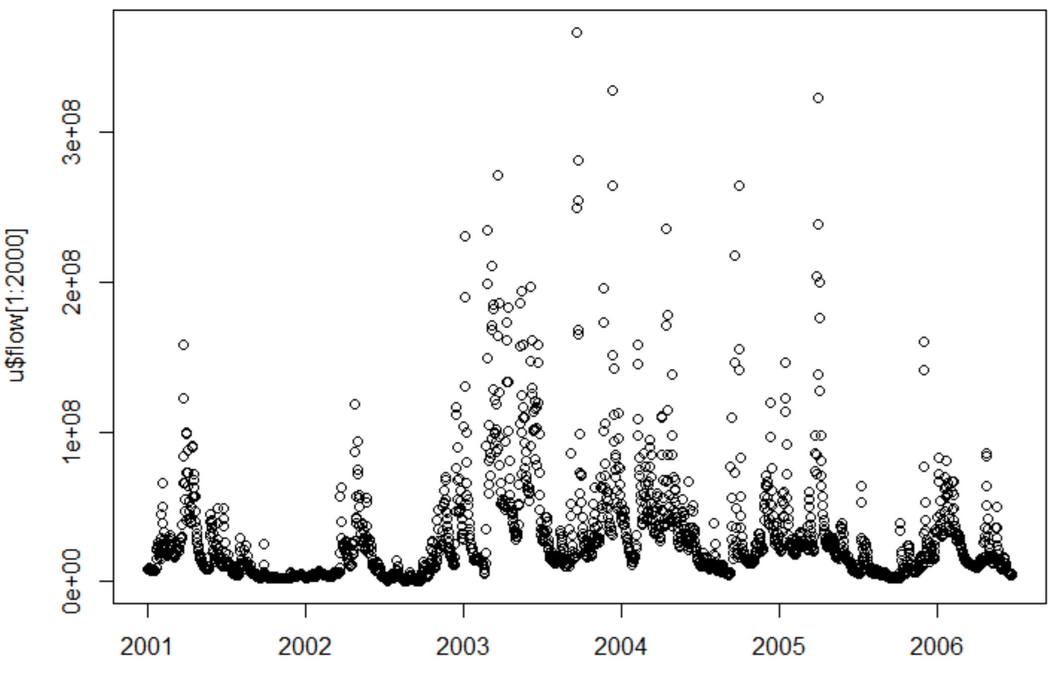
Example: time-series of stream flow

Slide 5
#download usgs gauge data (Streamflow for this example)
library(dataRetrieval)
discharge_stats <- readNWISdv(siteNumbers='02011400',
startDate = "1992-01-01",
endDate = "2021-12-31",
parameterCd=c("00060"))
plot(discharge_stats$Date, discharge_stats$X_00060_00003)

Slide 6
Additional examples?

Slide 7
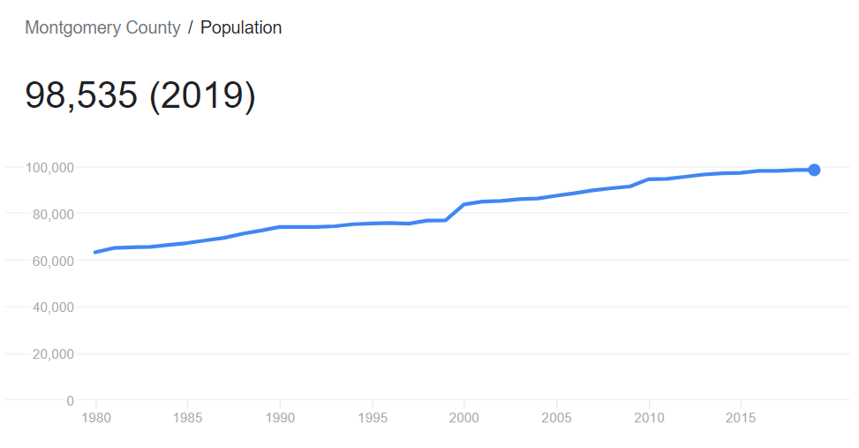

Slide 8
Time-series analysis (NDVIs)

Slide 9
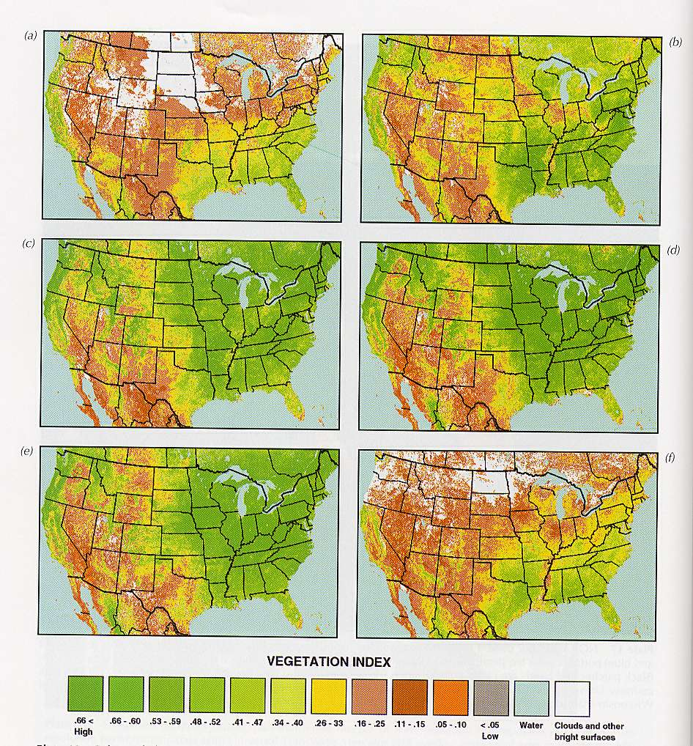
NDVI from AVHRR for Phenology
Feb 27-Mar 12
Apr 24-May 7
Jun 19-Jul 2
Jul 17-Jul 30
Aug 14-Mar 27
Nov 6-19

Slide 10
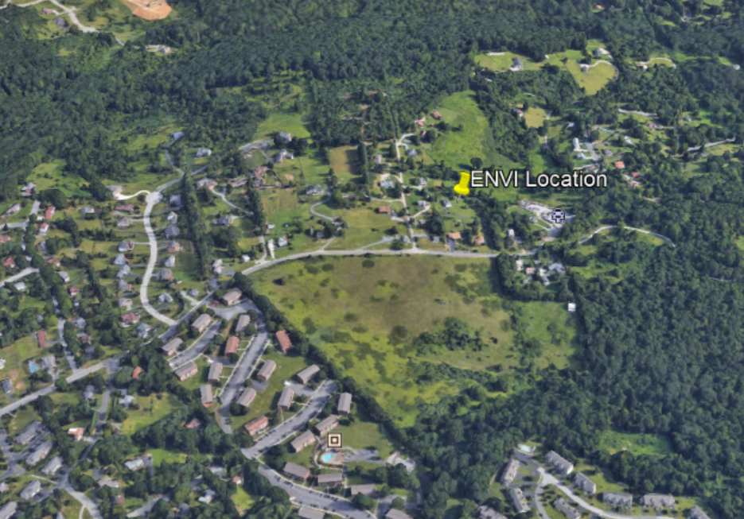
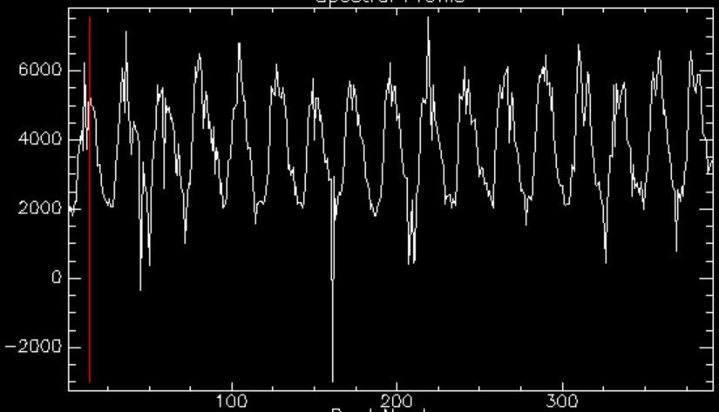
NDVI time-series

Slide 11
Read/Extract time series data
Plotting time series
Trend analysis
Change detection

Slide 12
Rscript demo (read csv and plot)
a<-read.csv('pptmonthly.csv')
d_month<-seq(as.Date("2001-01-01"), as.Date("2019-12-31"), by="months")
plot(d_month,a$pcp,type='l',xlab='year',ylab='ppt')
points(d_month,a$pcp)

Slide 13
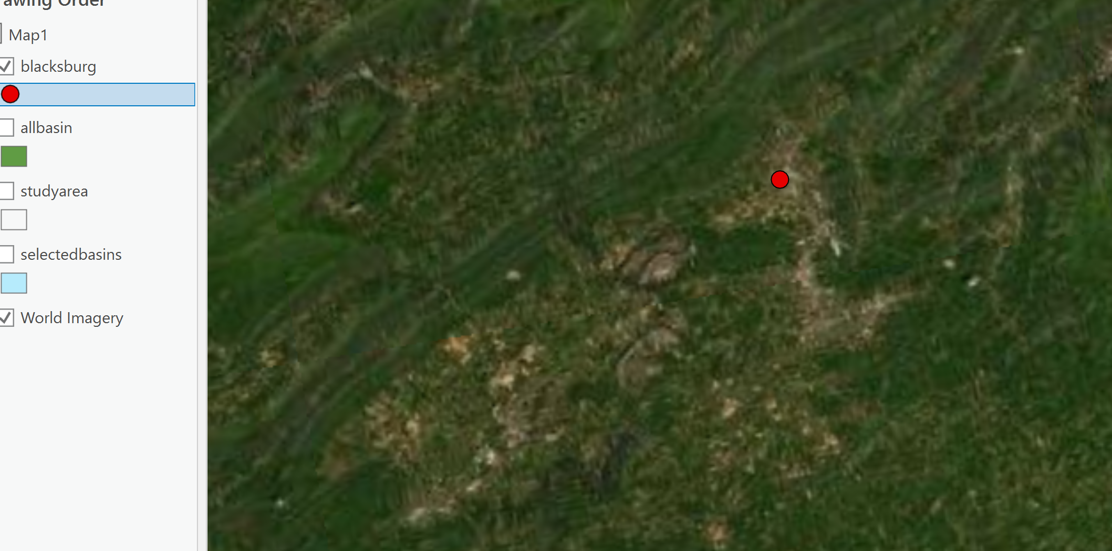
Rscript demo
Download prism data; extract temperature values for a point location
library(prism)

Slide 14
Read/Extract time series data
Plotting time series
Trend analysis
Change detection

Slide 15
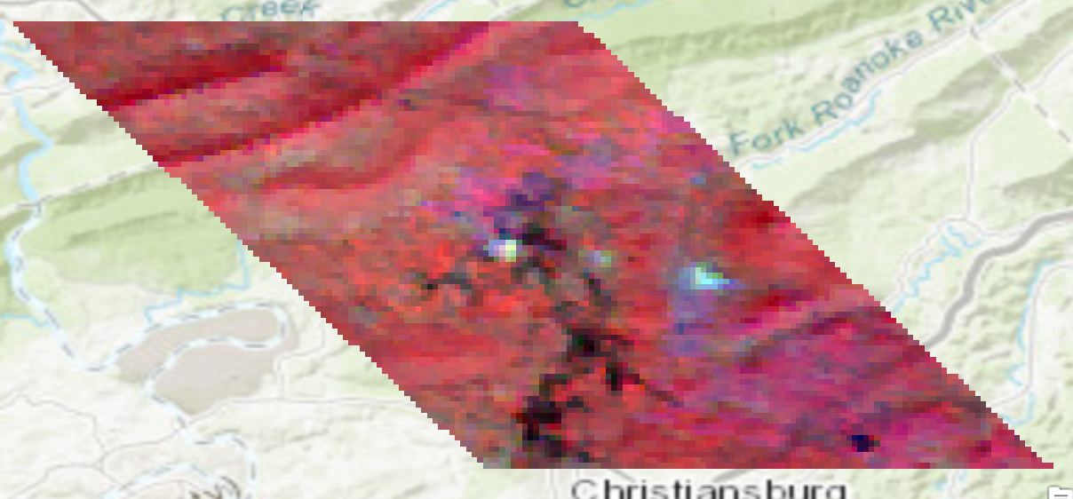
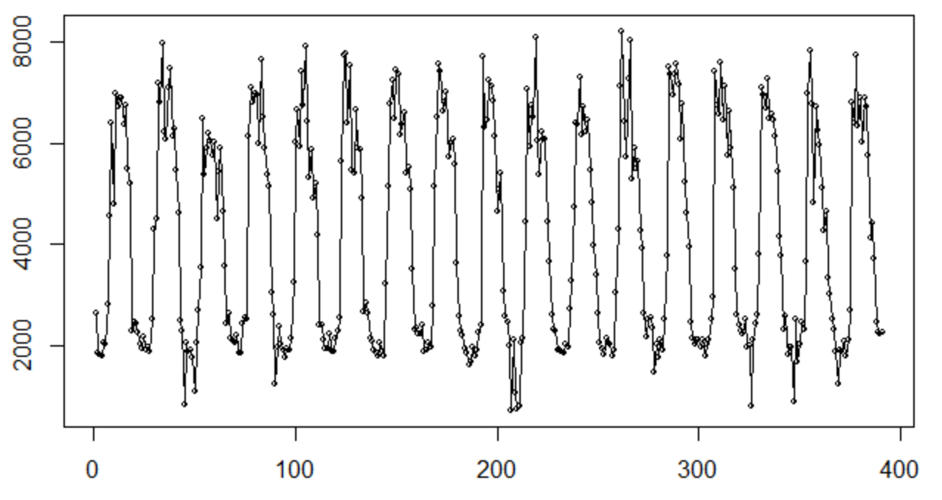
More examples: remote sensing time-series data
2001-2017
Each year 23 observations

Slide 16
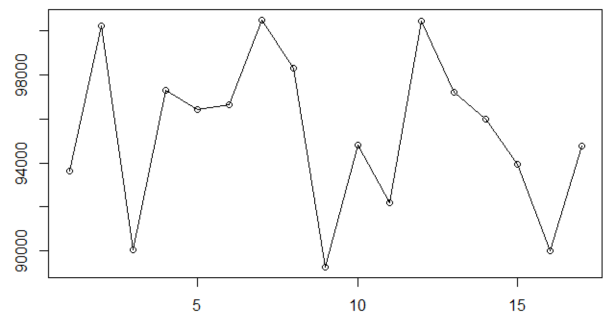
Annual-EVI (2001-2017)

Slide 17
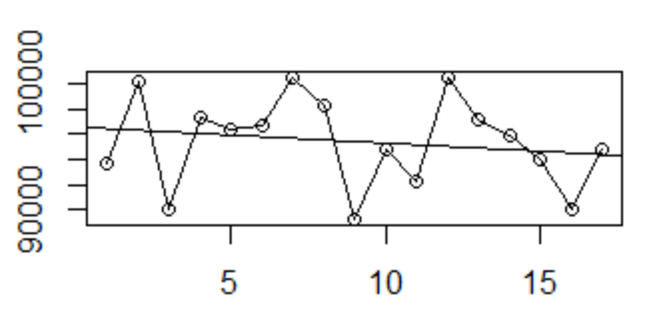
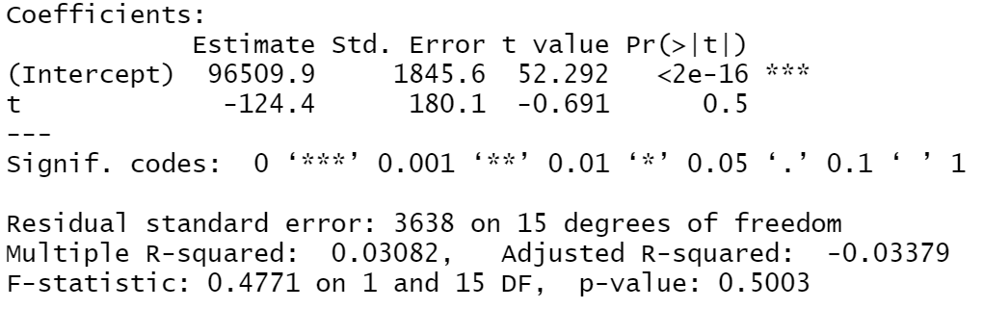
Trend analysis
Regression line (y~a+b*t)
NDVI against time (year)

Slide 18
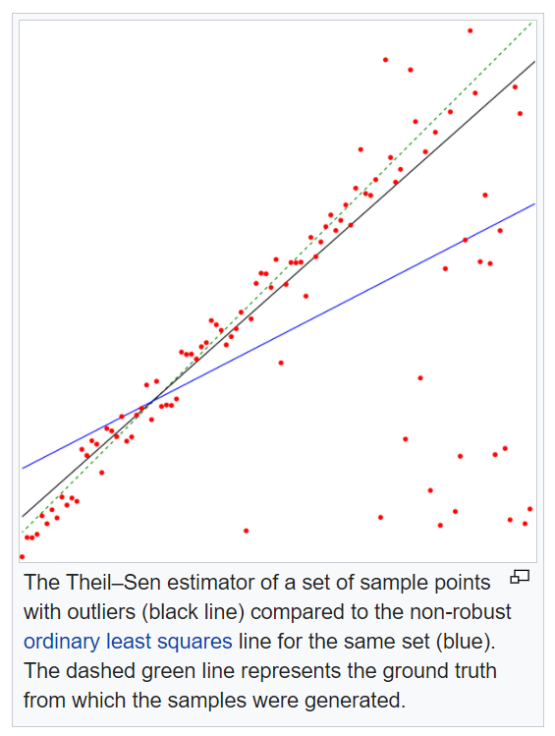
Rscript demo: trend analysis
1. The usual method for estimating the slope of a regression line that fits a set of (x, y) data elements is based on a least squares estimate.
lmodel<-lm(ndvi~year,data=df)
2. Sen’s slope:
Nonparametric estimate of the slope; Sen’s slope is defined as the median m of the slopes (y_{j} − y_{i})/(x_{j} − x_{i}) determined by all pairs of sample points
library(trend)
sens.slope(ndvi,conf.level = 0.95)
Source: https://en.wikipedia.org/wiki/Theil%E2%80%93Sen_estimator

Slide 19
Fit trend line (or Sen’s slope) for each pixel?

Slide 20
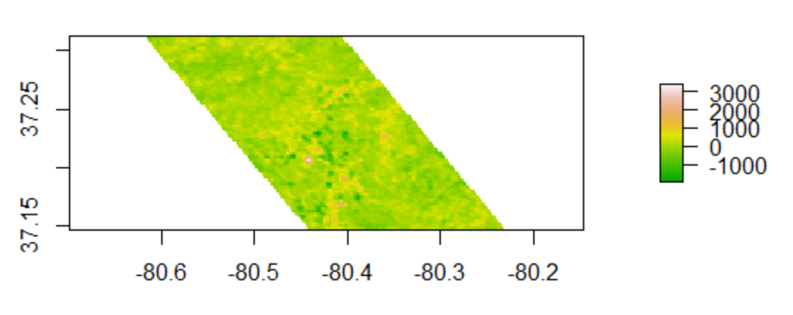

Slide 21
Reading Time Series Data
Plotting Time Series
Trend analysis
Change detection

Slide 22
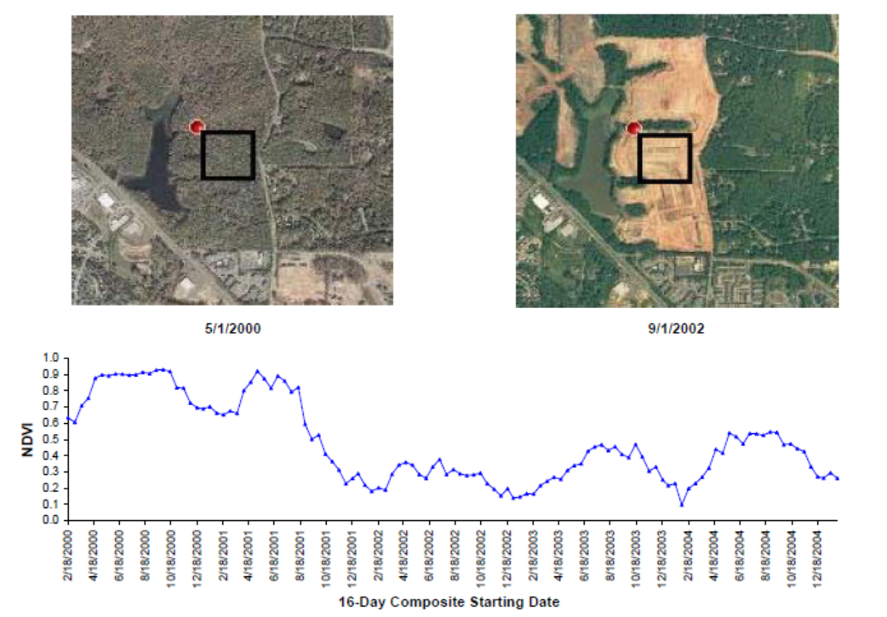

Slide 23
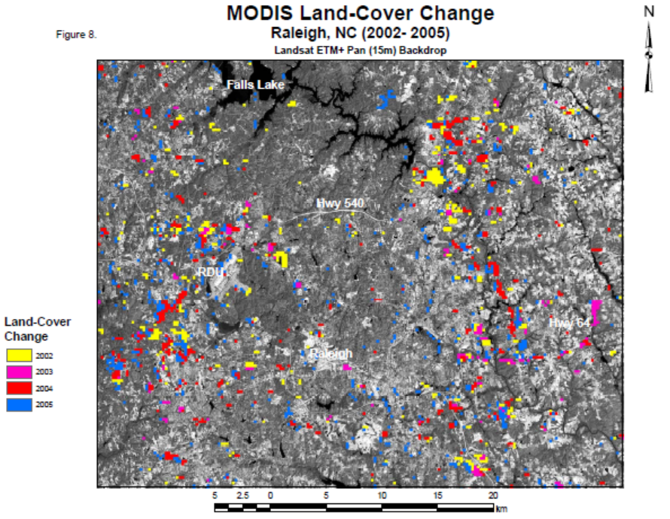

Slide 24
Source: Lunetta et al. 2006

Slide 25
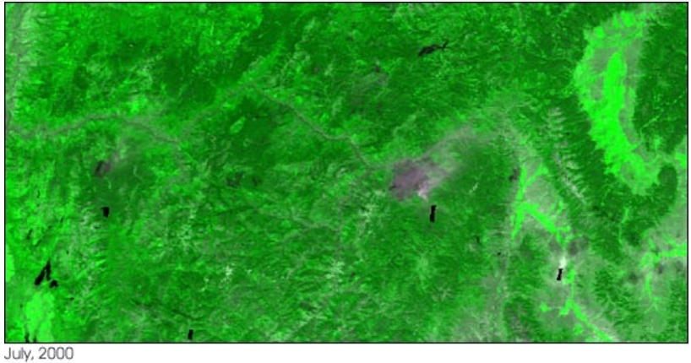
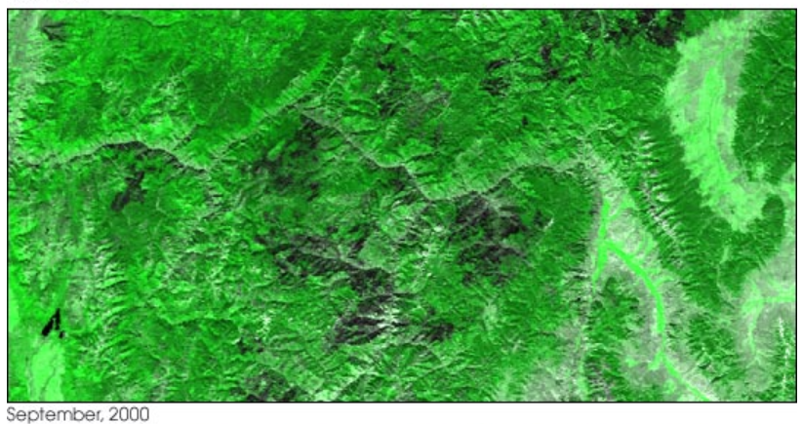
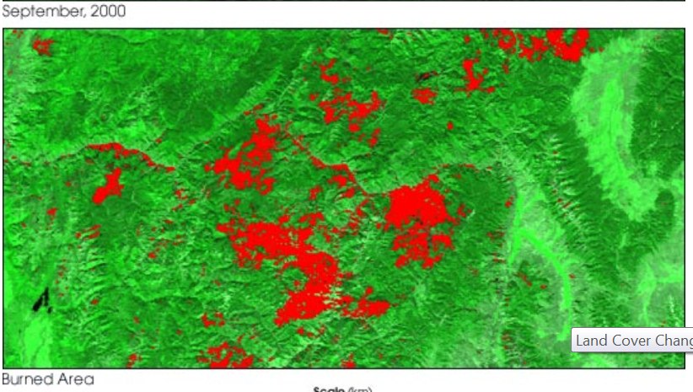
Wildfire detection
“MODIS’ 250-m resolution product will serve as an alarm system that warns scientists of possible significant land cover change. Scientists can then turn to higher-resolution sensors such as Landat-7, ASTER, or Ikonos for a detailed look at an area.”

Slide 26
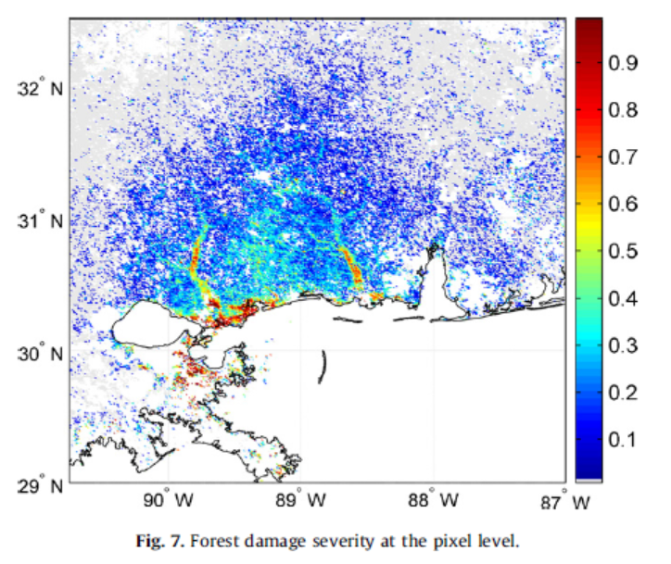
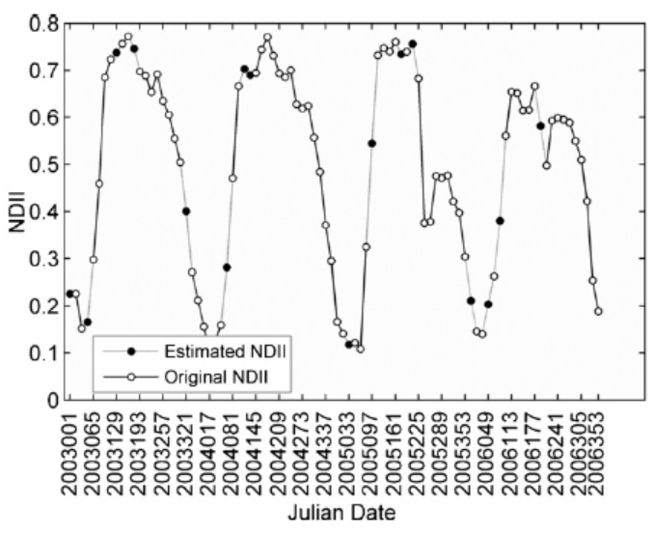
Post-hurricane forest damage assessment
Post-Hurricane Katrina
(Wang et al. 2010)

Slide 27
R script and demo
library(changepoint)
a<-st_read('Blacksburg.shp')
avalue<-extract(m,a_proj)
plot(avalue[1,])
fit_changepoint = cpt.mean(avalue[1,])
plot(fit_changepoint)
cp <- cpts(fit_changepoint)

Slide 28
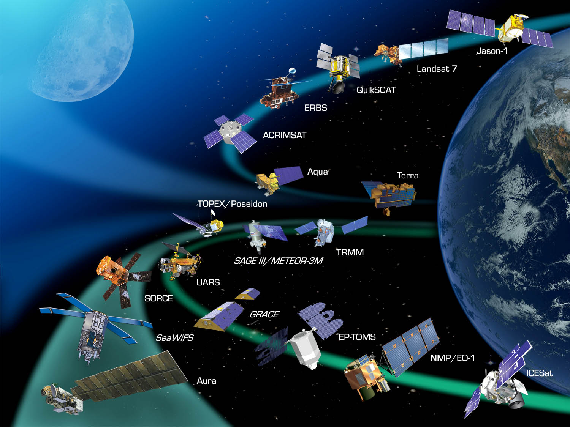
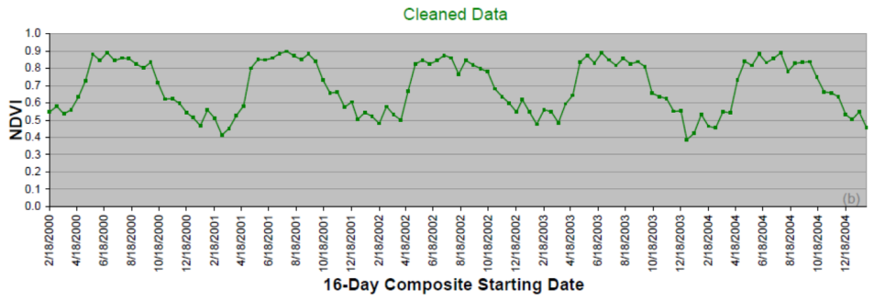
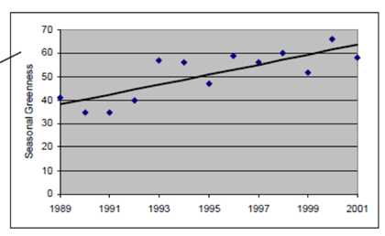
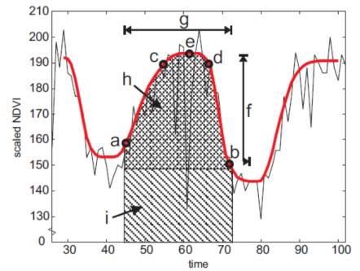
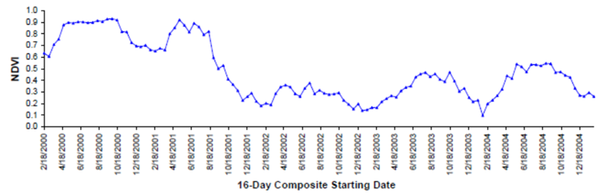
Analysis of Time Series Remote Sensing Data
Identify changes
Analyze trends
Estimate seasonality
parameters
• Human activity
Natural disaster
Temperature
• Precipitation
…..

